Slide 1
Block-Seminar:
Mixed Reality Applications for Human-Robot Collaboration
Andrea Kupitz
Fabian Spaniol
Felix Scherzinger
Malte Groß
Thorsten Schamper 26.08.2016

Slide 2
Overview
Hard- and Software
Progress
Demo
Attention areas
Schedule
Next steps

Slide 3
Hard- and Software

Slide 4
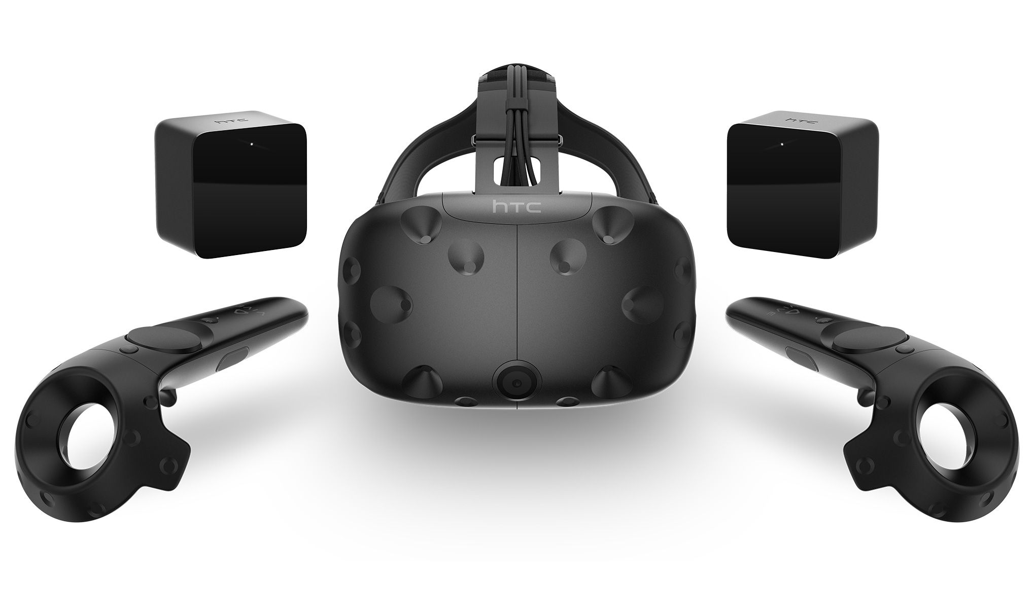
HTC Vive

Slide 5
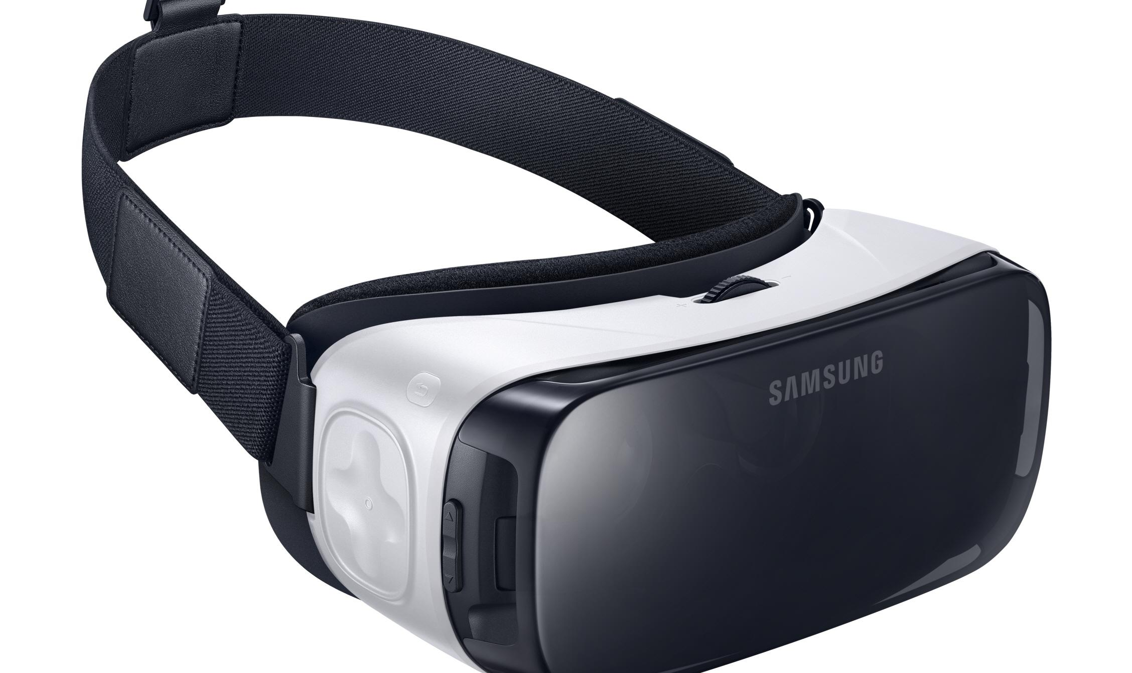
GearVR

Slide 6
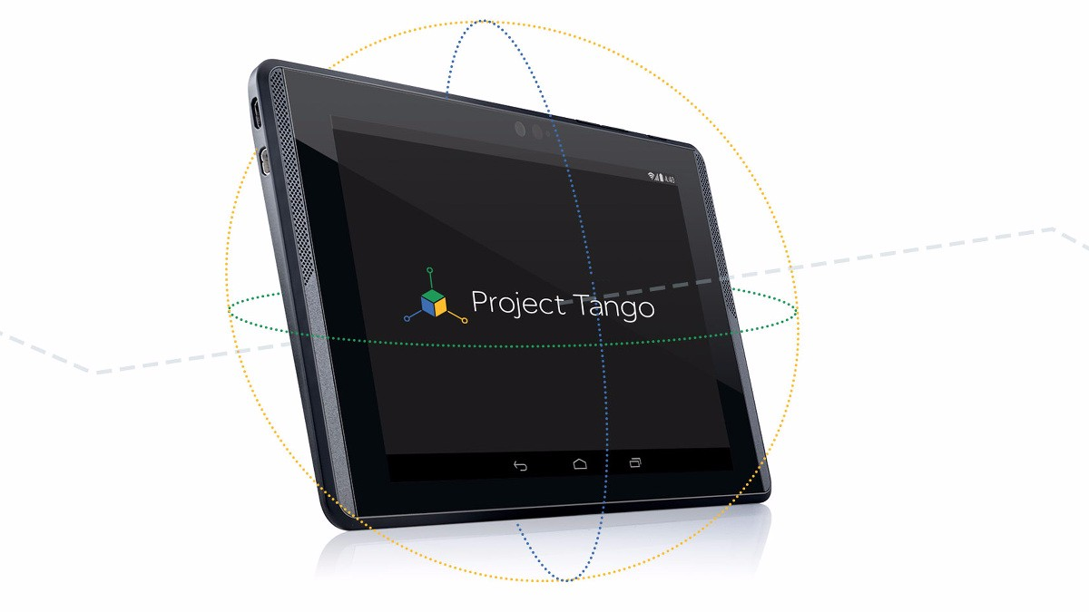
Project Tango

Slide 7

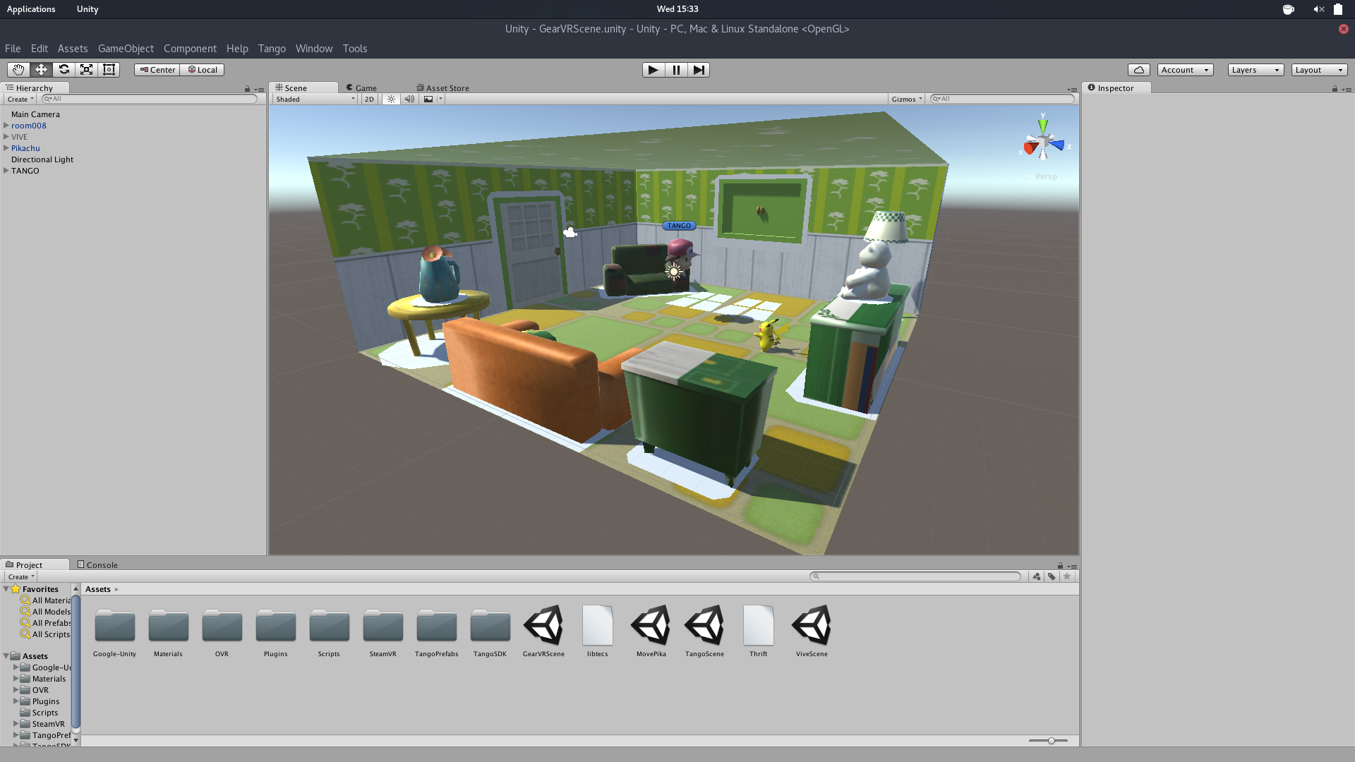
Unity3D

Slide 8
Video demo

Slide 9
Tango

Slide 10
GearVR

Slide 11
HTC Vive

Slide 12
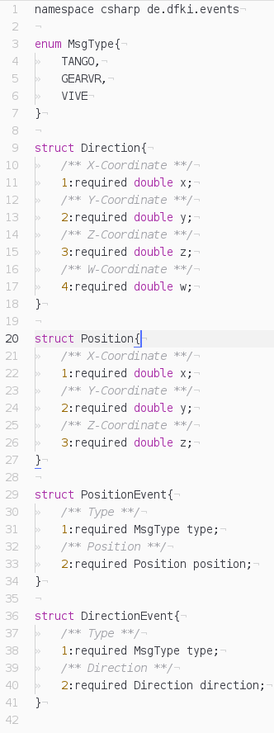
Progress
TECS communication
basic TECS-Server
different Events
every client can publish and subscribe
scene setup
temporary environment
for presentation purpose only
Project setup
Git repository
Project structure

Slide 13
Attention areas
HTC Vive loses connection
as soon as the sensorview of the user is interrupted
Tango throws exception
occurs on sudden and fast motions

Slide 14
Schedule

Slide 15
TECS communication between all devices
Desktop connection, final system architecture
final demo and video submission
26.08.16
02.09.16
09.09.16
23.09.16
30.09.16
Baxter communication, pick’n’place by Vive and GearVR
final implementation including features and interactions

Slide 16
Goals for next meeting
Communication with Baxter
Complete user visualization of all clients
Simple Baxter control by Vive and GearVR

Slide 17
Questions?

